Slide 1
AERONET-OC: Gloria
Giuseppe Zibordi
Istanbul, 10-11 November 2011.

Slide 2
Requirements for field data supporting cal/val programs
Traceable (with defined uncertainties quantified, when appropriate, through reference standards);
Globally distributed (ideally representing the wide range of geophysical conditions that remote sensing products are expected to observe);
Continuous (time-series of quality assured data are fundamental for assessing remote sensing products from successive space missions);
Cross-site consistent (uncertainties should be likely the same for all measurement sites and measurement conditions);
Accessible (availability through suitable data policies, is a key element for any cal/val program).

Slide 3
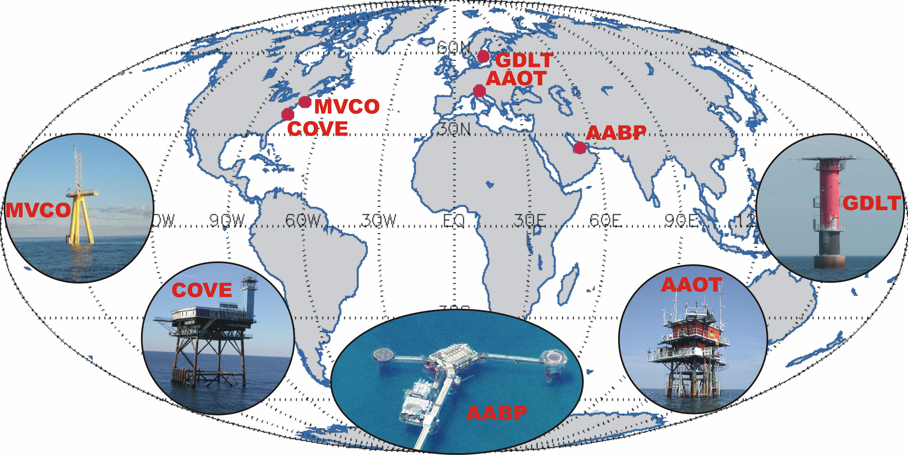
AERONET-OC
AERONET – Ocean Color is a sub-network of the Aerosol Robotic Network (AERONET), relying on modified sun-photometers to support ocean color validation activities with highly consistent time-series of L_{WN}(λ) and τ_{a}(λ).
Rationale:
Autonomous radiometers operated on fixed platforms in coastal regions;
Identical measuring systems and protocols, sensor calibrated using a single reference source and method, and data processed with the same code;
Standardized products of normalized water-leaving radiance and aerosol optical thickness.
G.Zibordi et al. A Network for Standardized Ocean Color Validation Measurements. Eos Transactions, 87: 293, 297, 2006.

Slide 4
AERONET-OC: the network elements
2
SeaPRISM
4
1
3
5
6
SeaPRISM
Satellite or PC
AERONET
Cal-service
SeaPRISM
AERONET-OC
Products
WEB
Calibration service performed by JRC (from 2002 to 2008) and GSFC (from 2009) for above-water radiometric measurements (comparisons between JRC and NASA have shown differences on average below 2%).
SeaPRISMs operated from fixed deployment platforms.
Meteorological satellites (i.e., METEOSAT, GOES) or computers.
AERONET-OC data handling system (part of AERONET).
Marine and atmospheric QA products (i.e., L_{WN} and τ_{a}(λ) at the 412, 443, 488, 531, 551, 667, 870 and 1020 nm nominal center-wavelengths).
Products accessibility through internet with a specified data policy.

Slide 5
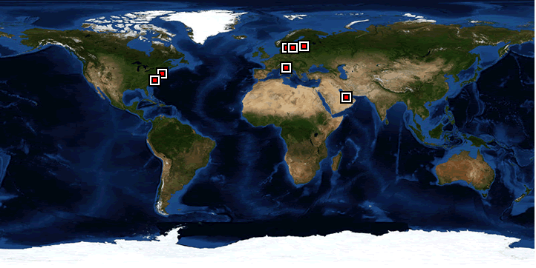
AERONET-OC (2002-present)
Current sites
Planned sites
Potential sites
Current management and responsibilities
NASA manages the network infrastructure (i.e., handles the instruments calibration and, data collection, processing and distribution within AERONET).
JRC has the scientific responsibility of the processing algorithms and performs the quality assurance of data products.
PIs establish and maintain individual AERONET-OC sites.

Slide 6
Current AERONET-OC sites
Site | Region | Lon. | Lat. | Structure | Responsible Institution
AAOT (2002-ongoing) | Adriatic Sea | 45.314°N | 12.508°E | Oceanographic tower | Joint Research Centre (EU)
MVCO (2004-ongoing) | Mid-Atlantic Bight | 41.325ºN | 70.567ºW | Oceanographic tower | University of New Hampshire (USA)
GDLT (2005-ongoing) | Baltic Proper | 58.594°N | 17.467°E | Lighthouse | Joint Research Centre (EU)
COVE (2005-ongoing) | Mid-Atlantic Bight | 36.900°N | 75.710°W | Lighthouse | National Aeronautics and Space Administration (USA)
HLT (2006-ongoing) | Gulf of Finland | 59.949°N | 24.926°E | Lighthouse | Joint Research Centre (EU)
AABP (2006-2008) | Persian Gulf | 25.495°N | 53.146°E | Oil platform | Joint Research Centre (EU)
Palgrunden (2008-ongoing) | Palgrunden Lake | 58.753°N | 13.158°E | Lighthouse | University of Stockholm (S)
Lucinda (2009-ongoing) | Coral Sea | 18.519°S | 146.385°E | Jetty | Commonwealth Scientific and Industrial Research Organisation (AU)
LISCO (2009-ongoing) | Long Island Sound | 40.955°N | 73.342°W | Platform | City College of New York (USA)
WaveCIS_Site_CSI_6 (2010-ongoing) | Gulf of Mexico | 28.867°N | 90.483°W | Oil platform | Louisiana State University (USA)
Gloria (2010-ongoing) | Black Sea | 44.599°N | 29.360°E | Oil platform | Joint Research Centre (EU)

Slide 7
AERONET-OC data applications
Time Series for environmental analysis
Validation of primary ocean color products
Assessment of cross-mission primary products
Regional vicarious calibration of space sensors
Bias-reduction in regional primary products

Slide 8
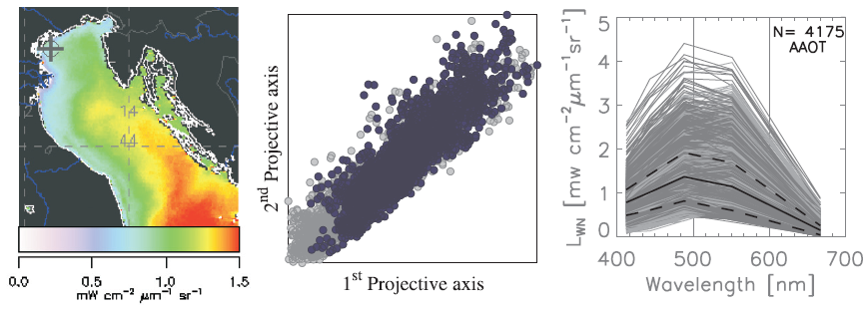
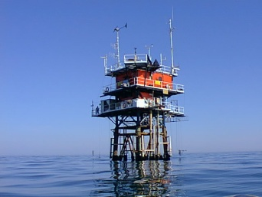
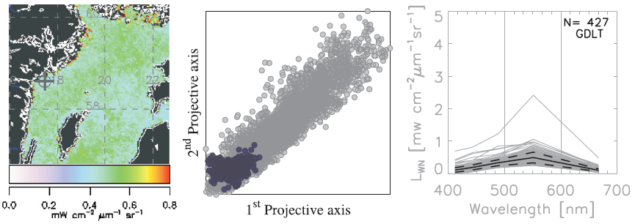
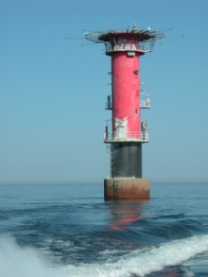
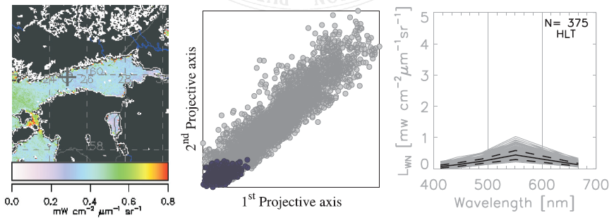
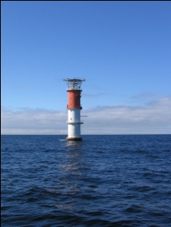
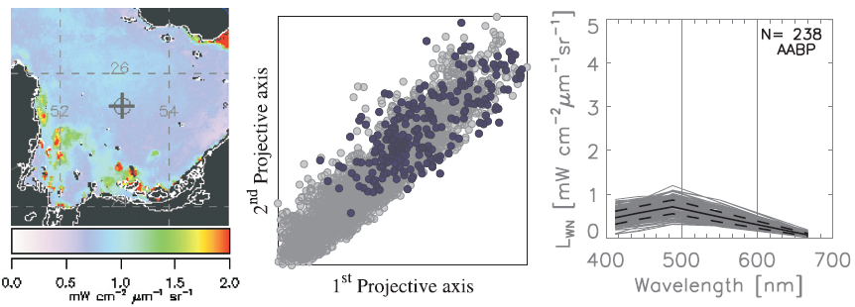
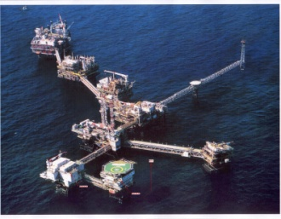
Site: AAOT
Location: Northern Adriatic Sea
Water type: Case-1/Case-2 (sed. dom.)
Water depth: 17 m (height: 15 m)
Distance: 8 nm
Period: 2002-present
Site: GDLT
Location: Northern Baltic Proper
Water type: Case-2 (y.s. dom.)
Water depth: 16 m (height: 26 m)
Distance: 9 nm
Period: 2005-present (summer)
Site: HLT
Location: Gulf of Finland
Water type: Case-2 (y.s. dom.)
Water depth: 13 m (height: 30 m)
Distance: 12 nm
Period: 2006-present (summer)
Site: AABT
Location: Persian Gulf
Water type: Case-1 (?)
Water depth: 23 m (height: 24 m)
Distance: 80 nm
Period: 2005-2008
Zibordi, G., Holben, B., Slutsker, I., Giles, D’Alimonte, D., Mélin, F., Berthon, J.-F., Vandemark, D., Feng, H., Schuster, G., Fabbri, B. E., Kaitala, S., Seppälä, J. (2009). AERONET-OC: a network for the validation of Ocean Color primary radiometric products. JTECH 26, 1634-1651.

Slide 9
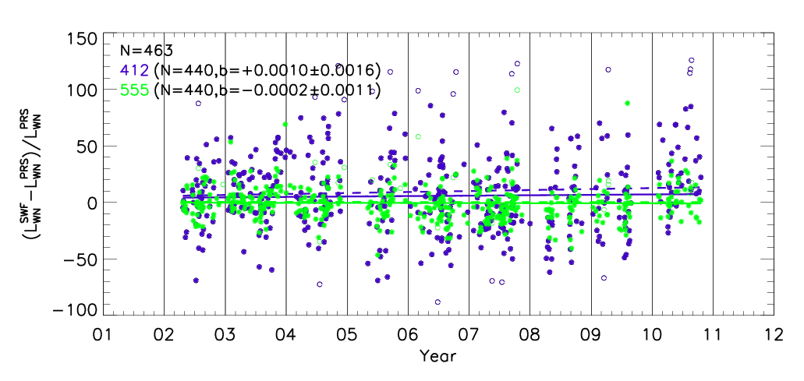
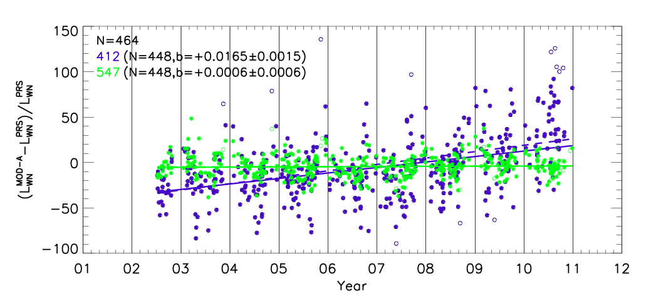
Inter-Annual Stability of
Satellite Ocean Color Sensors

Slide 10
Assessment of
Satellite Ocean Color Primary Products

Slide 11
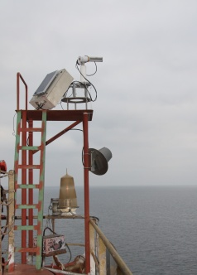
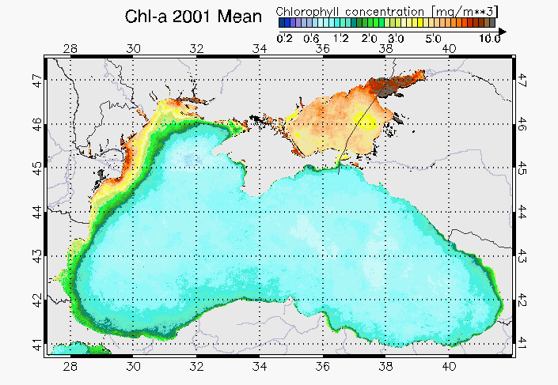
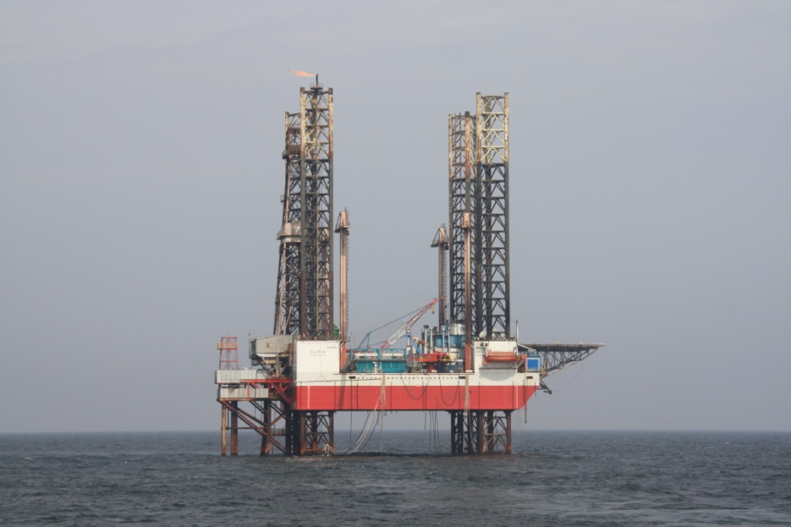
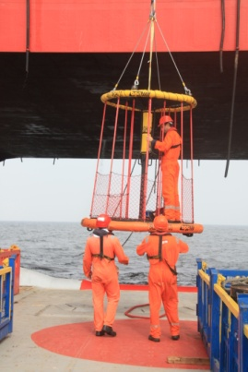
Gloria
SeaPRISM
Gloria
Site: Gloria
Location: Black Sea
Water type: Case-2 (sed. dom.)
Water depth: 50 m (height: 30 m)
Distance: ~20 nm
Period: 2010-present
Gloria Platform
Complex Logistics

Slide 12
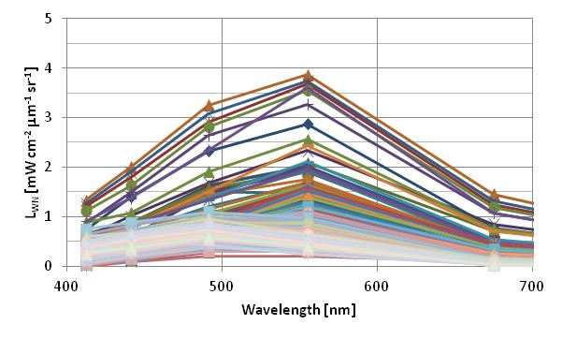
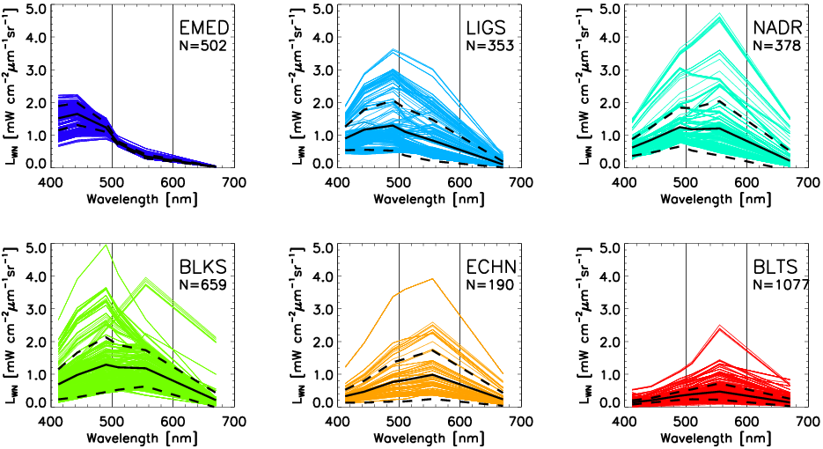
L_{WN} from Gloria
Gloria
(2011)
BiOMaP
(2000-2009)

Slide 13
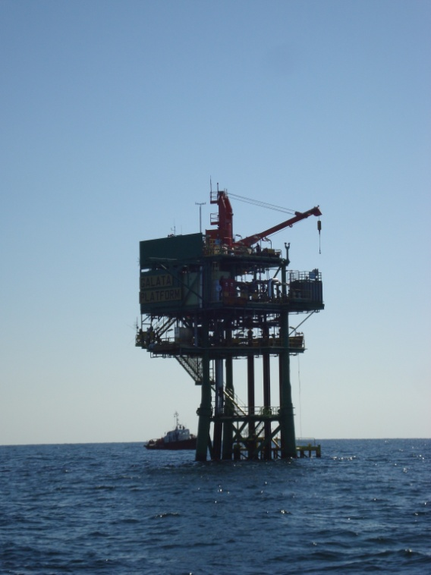
Future AERONET-OC Site in the Black Sea?
Gloria
Galata

